Slide 1
Employee Data Analysis using Excel
STUDENT NAME: V.SREE VARSHINI
REGISTER NO: 312216201
DEPARTMENT: B.COM (BANK MANAGEMENT)
COLLEGE: SHRI SHANKARLAL SUNDARBAI SHASUN JAIN COLLEGE FOR WOMEN.

Slide 2
PROJECT TITLE
Employee Performance Analysis using Excel

Slide 3


AGENDA
Problem Statement
Project Overview
End Users
Our Solution and Proposition
Dataset Description
Modelling Approach
Results and Discussion
Conclusion
3/21/2024 Annual Review

Slide 4

PROBLEM STATEMENT
Organization,assessing employee performance is crucial for making informed decisions about promotion, compensation, training need & overall workforce management

Slide 5

PROJECT OVERVIEW
.
The project overview provided a summary of a project, including its key aspects and general approach.It is give clear understanding of readers what the project is about
Purpose: The purpose of this Excel based employee performance analysis is to streamline and enhance the evaluation of employee performance within an organization.

Slide 6

WHO ARE THE END USERS?
The end user of employee performance analysis are the employees themselves,as well as their managers and supervisors and the organization.

Slide 7

OUR SOLUTION AND ITS VALUE PROPOSITION
Our solution providers a robust Excel based tool designed for comprehensive employee performance analysis.
An employee value proposition Is a set of benefits and rewards that an organization offers to employees in exchange for their skills, experience and commitment .
It’s a statement of the company value, culture and support that employees receive to do their best work .

Slide 8
Dataset Description
Employee information: employee ID ,name, department,date of birth .
Performance: performance review, quality scores , performance level.
Employee status: business units, department types, employee types, current employee rating.

Slide 9

THE "WOW" IN OUR SOLUTION
Performance level
Very high: 2
High : 6
Low : 22
Grand total: 30
3/21/2024 Annual Review
9

Slide 10
MODELLING
DATA COLLECTION
Employee Data
FEATURE COLLECTION
Name
Date of birth
Employee ID
Department
Gender
Business units
Performance LEVEL
High
Medium
Low
10

Slide 11
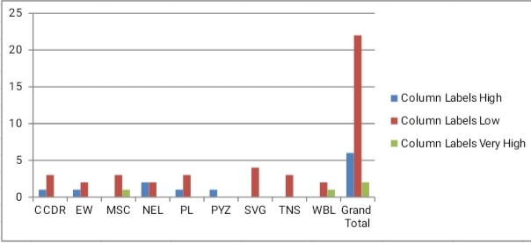
RESULTS
11

Slide 12
conclusion
Employee performance analysis is essential for understanding workforce effectiveness. We various visualization to analyse and present employee performance data.

